Slide 1
To scan, or not to scan - that is the (common) question.
Katarina Creese
Lionel Kowal
OMC alumni
20 March 2017

Slide 2
64 year old male
Onset of vertical diplopia about 18 years ago
Dx of right CN IV palsy in 2006 – managed in NSW

Slide 3
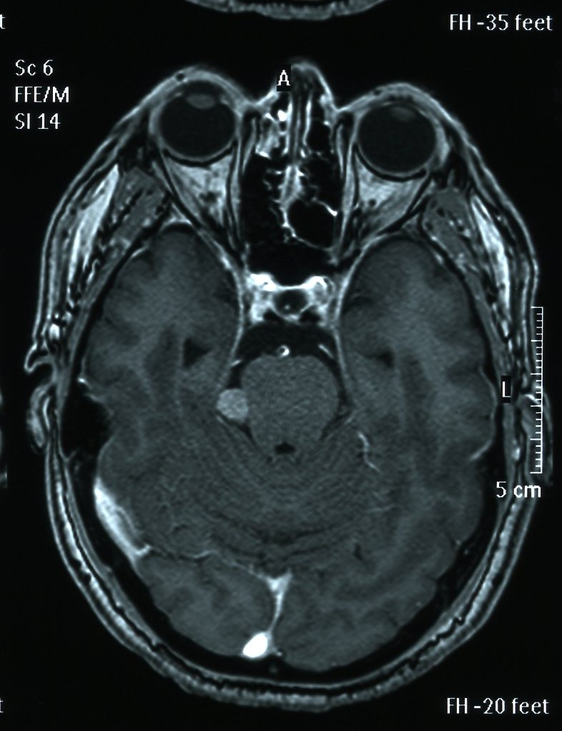
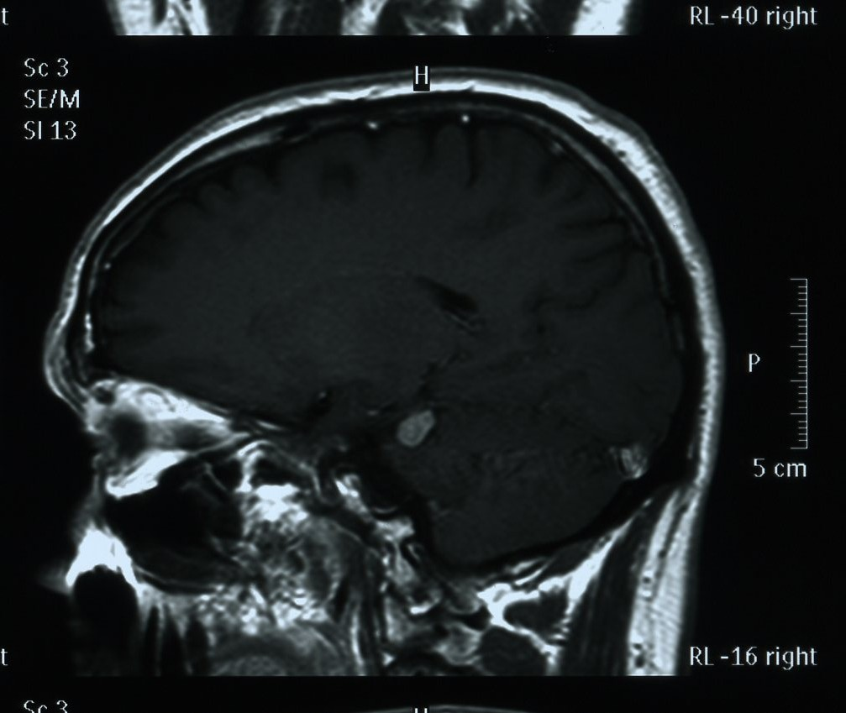
MRI 2006

Slide 4
Dx of infratentorial meningioma – or schwannoma?
Along the way he had R inferior oblique myectomy – no improvement

Slide 5
December 2016 – referred to Melbourne
VAR 6/9, VAL 6/8
Titmus test - fly
Troublesome diplopia (had to give up work) – wears prisms for reading but still needs to close 1 eye to be able to read.
Left head tilt – sore neck

Slide 6
December 2016
Maddox rod
2LH* |  | 19RH
0 | 6RH | 25RH
5RH |  | 25+RH
*post-operative after R inferior oblique surgery

Slide 7
December 2016
0△ |  | 10△
4△ | 9△ | 20△
10△ |  | 25△
Tight RSR
RIR under action
Tight superior rectus can be confirmed with
Forced duction test
Forced tilt test - >10△: tight SR
Large excyclotorsion 15deg
Notes:
The finding is: RIR UA - The usual cause of that in a long standing hypertrophic- of- any- cause is a tight superior rectus
Tight SR can be confirmed with intra-op FDT [can guess it with in-office FDT with forceps or through- the- lid FDT]
If forced tilt test >10^, Jampolsky says is due to tight SR

Slide 8
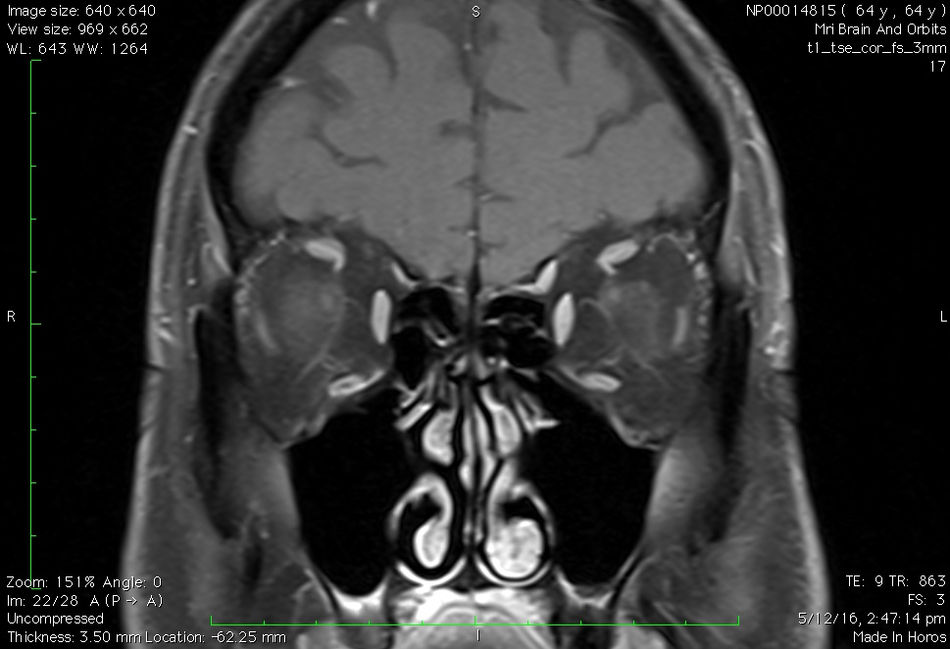
MRI showing R superior oblique atrophy not previously described (orbits not included on previous imaging)

Slide 9
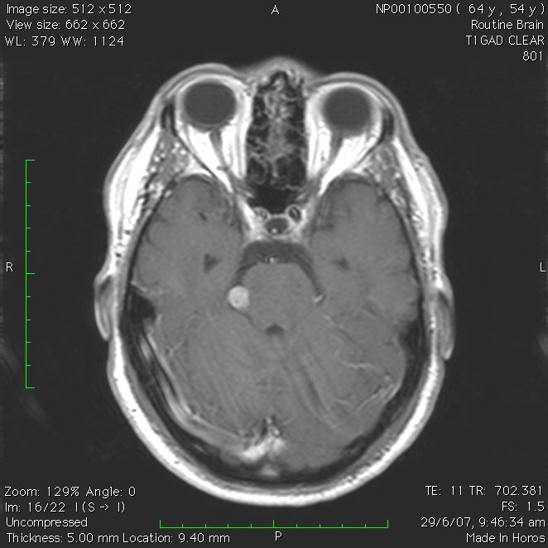
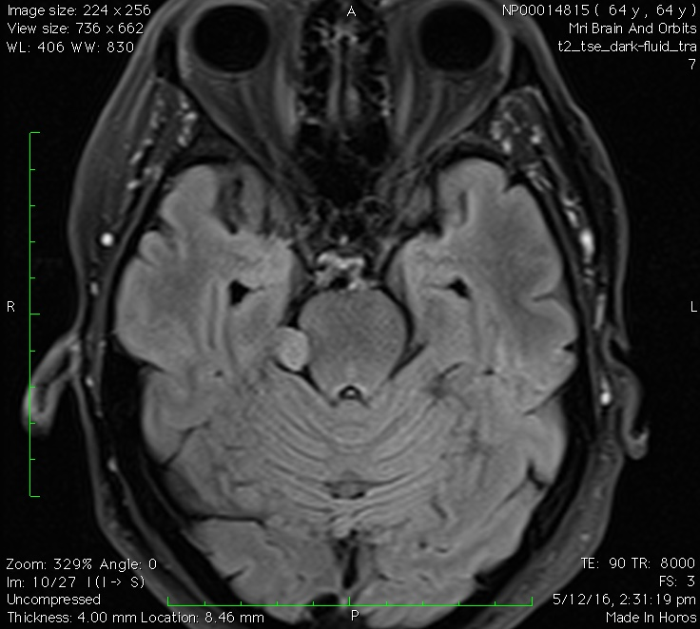
Minimal growth overtime (2mm over eleven years)
2006
2012
2016

Slide 10
What next?

Slide 11
If RSO atrophic – in 20% of cases floppy tendon present
  Surgical option 1 - if floppy tendon: do superior oblique tightening (only by a surgeon experienced in this type of surgery)
    Imaging of the SO tendon is recommended as part of the evaluation of patients with (probable) SOP to segregate those with atrophy. 20% of the group with radiological atrophy are likely to have floppy tendons and possibly require SOT, a more difficult and higher morbidity procedure than the more commonly performed inferior oblique surgeries for SOP. (Kowal and Mitchell)
  Surgical option 2 – if not floppy tendon: recess – resect LIR with adjustable Faden suture, transpose nasally to reduce excyclotorsion
Neurosurgery discussed (consideration of radiosurgery) – removal of lesion technically possible but likely to worsen diplopia

Slide 12
Frequency of unilateral isolated CN IV palsy or paresis
Overdiagnosed? Simonsz et al (1988) – 50% of superior oblique “palsy” diagnosed by strabismus specialists NOT neurogenic (50% got it wrong…)
  Tested with succinylcholine stimulation during surgery – if superior oblique does not contract = paresis

Slide 13
  Simulating lesions
    Pulley disorders (Velez et al, 2000)
    Graves orbitopathy (Chen et al, 2008)
    Anatomical causes (Siepmann and Herzau, 2005)
    Tumour – an extremely rare cause (Elmalem et al, 2009)
    Posteroplaced trochlea (Bagolini,1982)
    Anomalous anatomy (Fink, 1962)

Slide 14
  Should every 4th nerve palsy be imaged?
  … probably yes, especially if planning to treat
  (to separate superior oblique atrophy cases from
  non–atrophic causes)
Most reliable way to diagnose SOP = MRI of the muscles – radiological evidence of superior oblique atrophy = palsy

Slide 15
SO has a medial and lateral compartment
    lateral compartment inserts behind the equator and is responsible for vertical globe movement
    medial compartment inserts in front of the equator and is responsible for incyclotorsion
Suh et al, 2016

Slide 16
Summary
Not every possible CN IV palsy is ‘idiopathic' or ‘late presentation of congenital fourth' - how hard should we look for a cause?
Radiological atrophy is a necessary condition for a definitive diagnosis of superior oblique palsy (Demer, Siepmann)

Slide 17
Literature
Suh, Soh Youn, et al. "Extraocular Muscle Compartments in Superior Oblique PalsyMuscle Compartments in Superior Oblique Palsy." Investigative ophthalmology & visual science 57.13 (2016): 5535-5540.
Shin, Sun Young, and Joseph L. Demer. "Superior oblique extraocular muscle shape in superior oblique palsy." American journal of ophthalmology 159.6 (2015): 1169-1179.
Siepmann, K., and V. Herzau. "Is congenital superior oblique strabismus a paretic disorder?--A magnetic resonance tomographic study." Klinische Monatsblatter fur Augenheilkunde 222.5 (2005): 413-418.
Simonsz, H. J., et al. "Length-tension curves of human eye muscles during succinylcholine-induced contraction." Investigative ophthalmology & visual science 29.8 (1988): 1320-1330.
Elmalem, Valerie I., et al. "Clinical course and prognosis of trochlear nerve schwannomas." Ophthalmology 116.10 (2009): 2011-2016.
Siepmann K, Herzau V Is congenital SO strabismus a paretic disorder? Klin Monatsbl Augenheilkd May 2005
Chen, Vicki M., and Linda R. Dagi. "Ocular misalignment in Graves disease may mimic that of superior oblique palsy." Journal of Neuro-Ophthalmology 28.4 (2008): 302-304.
Velez, Federico G., Robert A. Clark, and Joseph L. Demer. "Facial asymmetry in superior oblique muscle palsy and pulley heterotopy." Journal of American Association for Pediatric Ophthalmology and Strabismus 4.4 (2000): 233-239.

